Slide 1
Topic #2: Grip Strength Data
Jenny Reid, MA – CIDP Indication Lead, US Marketing
Katerina Anokhina, MD, MFPM – Director, Global CIDP Medical Affairs & Evidence Generation
Nadia Zaveri, PharmD – Director, US CIDP Medical Affairs and Evidence Generation

Slide 2
Grip Strength
RESEARCH FINDINGS:
GS is a familiar and objective tool used to assess disease activity in patients with CIDP based on internal market research conducted ​
~87% of HCPs use GS a majority of the time in most of their patients​
~40%-50% of HCPs use GS for all patients​
HCPs relate to improvement in GS and see it as supportive of sustained improvement in their patients with CIDP
HCPs found the sustained GS improvement demonstrated in ADHERE to be differentiating and impactful
BACKGROUND:
A majority of neurologists indicate that they assess grip strength (GS) in their evaluation of patients, but limited data around grip strength and its correlation to improvement in CIDP patients exist
Monitoring disease progression in CIDP is challenging; scales used in clinical trials are infrequently used in practice and are viewed as too subjective, potentially causing delay in recognition of worsening​ of CIDP
CIDP, chronic inflammatory demyelinating polyradiculoneuropathy; GS, grip strength; HCP, health care provider.
Notes:
Questions
Do you use grip strength measurements in your clinical practice?
How often are you remeasuring your patients’ grip strength?
In your opinion, is measuring grip strength practical and feasible?

Slide 3
Normal Grip Strength Based on Merkies 2000
CREATIVE: Please format this slide to match the template and rekey this table. DONE
Table 2. Normal Values for Quantities GS Assessment With the Vigorimeter for Both Hands in Healthy Subjects (kPa)
 | Males |  | Females
Age (y) | 0.05 Quantile values per age span | Median values per age span | 0.05 Quantile values per age span | Median values per age span
5-9 | 42 | 53 | 38 | 48
10-14 | 59 | 95 | 53 | 73
15-19 | 72 | 122 | 63 | 90
20-24 | 89 | 146 | 72 | 106
25-29 | 101 | 154 | 76 | 112
30-34 | 110 | 153 | 76 | 112
35-39 | 115 | 148 | 76 | 109
40-44 | 115 | 141 | 74 | 104
45-49 | 111 | 134 | 73 | 98
50-54 | 105 | 126 | 71 | 92
55-59 | 94 | 116 | 67 | 84
60-64 | 83 | 106 | 63 | 76
65-69 | 74 | 97 | 58 | 71
70-74 | 66 | 91 | 54 | 67
75-79 | 57 | 82 | 48 | 63
80-84 | 50 | 75 | 43 | 59
≥85 | 37 | 64 | 35 | 54
GS, grip strength.
Merkies IS, et al. Muscle Nerve. 2000;23(9):1393-1401.
Notes:
Note: This publication is newer, specific in immune-mediated polyneuropathies context. Values are for both hands - https://pubmed.ncbi.nlm.nih.gov/10951442/

Slide 4

Grip Strength Is Higher in Males, but Decreases With Age in Both Sexes¹
Grip Strength (Dominant Hand) in Adults Using the Martin Vigorimeter^{1,a}
Typical age of individuals with CIDP at diagnosis²
These reference values may serve as a guide for interpreting grip strength measurements in individuals with disability due to disease¹
CIDP, chronic inflammatory demyelinating polyradiculoneuropathy.
ªMeasurements were recorded in kp/cm², where 1 kp/cm² = 98.1 kPa. Data were converted and plotted in kPa.¹
1. Thorngren KG, Werner CO. Acta Orthop Scand. 1979;50(3):255-259. 2. Van den Bergh PYK, et al. Eur J Neurol. 2021;28(11):3556-3583.
Notes:
Grip strength, measured using the Martin Vigorimeter in the dominant hand, is higher in males but decreases with age in both sexes
The average grip strength in males 41-60 years of age decreases over time and ranges from approximately 104 to 80 kPa
The average grip strength in females 41-60 years of age decreases over time and ranges from approximately 88 to 73 kPa
[Click “Grip strength” to return to the overview slide of grip strength assessment tools]
[OPTIONAL – REACTIVE: Click “Jamar Dynamometer” to refer audience to a slide on age and sex differences observed with the Jamar Dynamometer]
Reference:
Thorngren KG, Werner CO. Normal grip strength. Acta Orthop Scand. 1979;50(3):255-259. doi:10.3109/17453677908989765

Slide 5
Grip Strength Is Higher in Males, but Decreases With Age in Both Sexes¹
Grip Strength (Dominant Hand) in US Adults Using the Jamar Dynamometer^{1,a}
Typical age of individuals with CIDP at diagnosis²
Normative reference values may serve as a guide for interpreting grip strength measurements for different adult US populations¹
CIDP, chronic inflammatory demyelinating polyradiculoneuropathy.
ªThe Jamar Dynamometer quantifies force in pounds (0-200) or kilograms (0-90).¹
1. Wang YC, et al. J Orthop Sports Phys Ther. 2018;48(9):685-693. 2. Van den Bergh PYK, et al. Eur J Neurol. 2021;28(11):3556-3583.
Notes:
Grip strength, measured using the Jamar Dynamometer in the dominant hand, is higher in males but decreases with age in both sexes
The average grip strength in males 40-64 years of age decreases over time and ranges from approximately 103 to 85 pounds
The average grip strength in females 40-64 years of age decreases over time and ranges from approximately 66 to 52 pounds
[Click “Grip strength” to return to the overview slide of grip strength assessment tools]
[OPTIONAL – REACTIVE: Click “Martin Vigorimeter” to refer audience to a slide on age and sex differences observed with the Martin Vigorimeter]
Reference:
Wang YC, Bohannon RW, Li X, Sindhu B, Kapellusch J. Hand-grip strength: normative reference values and equations for individuals 18 to 85 years of age residing in the United States. J Orthop Sports Phys Ther. 2018;48(9):685-693. doi:10.2519/jospt.2018.7851
Questions:
1) Do you check your patients baseline versus normative values?
2) Do you expect your patients with CIDP to achieve normative levels of grip strength while on treatment?
3) Do you use the normative values to track progress while receiving treatment?

Slide 6
Grip Strength Initiative
BACKGROUND/RATIONALE:
A majority of neurologists indicate that they assess grip strength in their evaluation of patients, but limited data around grip strength and its correlation to improvement in CIDP patients exist
Research suggests that grip strength is the most common assessment tool that HCPs leverage
HCPs relate to improvement in grip strength and see it as supportive of sustained improvement in their patients with CIDP
POTENTIAL BROAD SCALE PULL-THROUGH
Pending the successful data analysis of grip strength from ADHERE, we would proceed to roll out this initiative across 2 workstreams
Providing grip strength devices to HCPs/patients and executing on additional disease education around the value of measuring grip strength and how it is a predictor of disease progression
Testing and inputting new grip strength analyses in core medical education and promotional assets
CIDP, chronic inflammatory demyelinating polyradiculoneuropathy; HCP, health care provider.
Notes:
Questions
If you do use grip strength, how do you use it in your clinical practice to measure treatment response and inform clinical decisions?
Which hand do you use for testing, or do you use both?

Slide 7
Clinically Meaningful and Sustainable Improvement
An increase of 8 kPa is considered the minimum clinically important difference
Efgartigimod demonstrated clinically meaningful and sustained improvement in grip strength
Participants demonstrated a clinically significant improvement of 17.5 kPa in dominant hand GS from run-in baseline to Week 36
Approximately 50.3% and 38.9% of participants experienced an improvement from run-in baseline of at least 16 and 24 kPa in grip strength, respectively, at ADHERE+ Week 36
GS, grip strength.
Notes:
Question:
If a patient improves their grip strength, what specific tasks does this improvement usually correlate with (eg, holding a pen)?

Slide 8
Among ADHERE Stage A Responders, Efgartigimod PH20 SC Treatment Resulted in CMI in Dominant Hand Grip Strengthª in ADHERE+
(Treatment assignment refers to participant treatment during stage B of AHERE)
20
10
IMPROVEMENT
Mean (SE) change from run-in baseline grip strength (dominant had), kPA
0
Stage B Placebo- Controlled
Stage A Open-Label
Open-Label Extension
-10
Run-in baseline ADHERE
Stage A baseline ADHERE
Stage B baseline ADHERE
Stage B last assessment ADHERE
Week 12 ADHERE+
Week 24 ADHERE+
Week 36 ADHERE+
Participants, n
Efgartigimod PH20 SC
Placebo SC
97
97
97
97
85
78
76
94
94
94
93
78
78
73
Improvement coincides with time on and off efgartigimod treatment. For Stage A responders, mean efficacy scores on efgartigimod in ADHERE+ were better than at ADHERE run-in baseline.
Stages | All participants, mean (SE) | Change from run-in baseline (mean)
Run-in baseline (n=191) | 46.6 (1.75) | -
Stage A baseline (n=191) | 38.5 (1.74) | −8.2 (0.71)
Stage B baseline (n=191) | 56.0 (1.80) | +9.4 (1.28)
ADHERE+ Week 36 (n=149) | 65.6 (2.32) | +17.5 (2.02)
CMI, clinically meaningful improvement; PH20, recombinant human hyaluronidase PH20; SC, subcutaneous.
ªAn increase of ≥8 kPa in grip strength¹ is considered the minimum clinically important difference.² Post hoc analysis included ADHERE Stage A responders with run-in baseline values.
ADHERE+ data cutoff: February 16, 2024.
1. Vabhoutte EK. Eur J Neurol. 2013;20(5):748-755. 2. Van den Bergh PYK, et al. Eur J Neurol. 2021;28(11):3556-3583.
Notes:
Questions
What are your thoughts on these data from the ADHERE trial?
When using grip strength to help make clinical decisions, what are the cut-off values for changing a treatment course?

Slide 9
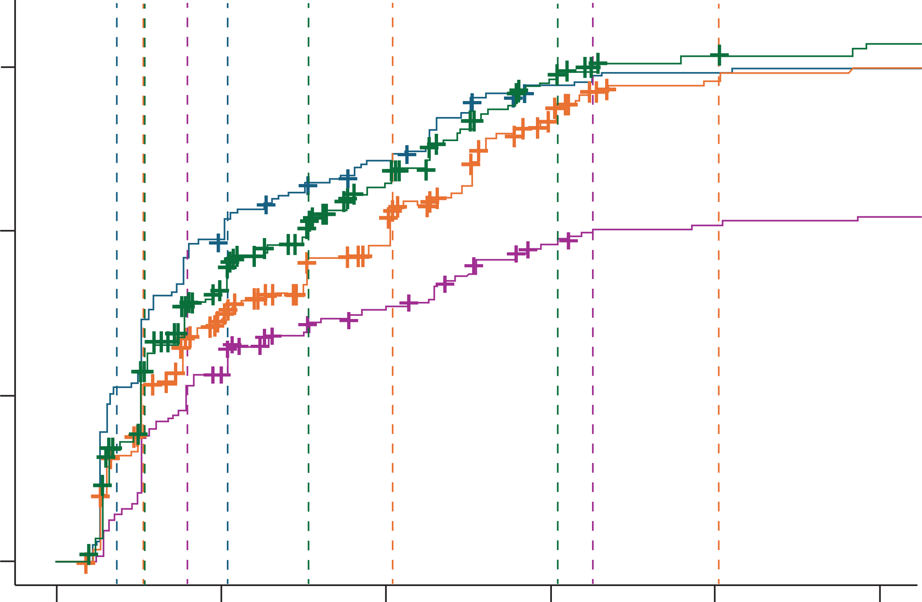
Speed of Response
 | 25% | 50% | 75%
Time to 8-kPA MGS improvement in either hand | 1.4 (1.3, 2.1) | 4.1 (3.1, 5.4) | 23.1 (10.1, NA)
Time to 16-kPA MGS improvement in either hand | 3.1 (2.4, 4.1) | 13.0 (10.1, 29.4) | NA (NA, NA)
Time to 1-point aINCAT Improvement | 2.1 (2.1, 3.1) | 8.1 (6.1, 9.5) | 16.1 (12.1, 38.3)
Time to 4-point I-RODS improvement | 2.1 (2.1, 2.3) | 6.1 (4.1, 7.4) | 12.1 (11.0, 32.1)
0.75
0.50
Probability of improvement
0.25
A similar proportion of participants reach a 1-point aINCAT, 4-point I-RODS, or 8-kPA MGS improvement. The median time to improvement is fastest for 8 kPa; median time to 16-kPa improvement is 13 weeks.
0.00
0
4
8
12
16
20
Time (weeks)
aINCAT, adjusted Inflammatory Neuropathy Cause and Treatment; I-RODS, Inflammatory Rasch-Built Overall Disability Scale; MGS, mean grip strength.
Notes:
Rationale: highlights speed of efficacy with VYVGART Hytrulo
Note: Time to first grip strength improvement may be slower and not as compelling as “time to first improvement” that’s currently included in the IVA, given that “time to first improvement” was calculated based on improvement on INCAT, I-RODS, or grip strength.
It would be helpful to compare time to first grip strength improvement with time to first aINCAT improvement (≥1 point improvement) in Stage A and Time to first I-RODs improvement (≥4 points improvement) in Stage A.
Questions
If a patient improves in their grip strength, what other improvements does this typically corelate with?
What are your thoughts on the relative speeds of improvement in each measure?

Slide 10
Durability of Response (16-kPa Deterioration in Either Hand and From Stage B Baseline)
Unpublished data
Strata
TRTA=EFG PH20 SC
TRTA=PBO PH20 SC
Cox model: HR = 0.3207
95% CI = [0.1753, 0.5866]
P<0.001
0.4
Probability of deterioration
0.2
0.0
Number at risk
TRTA=EFG PH20 SC
TRTA=PBO PH20 SC
0
111
109
4
107
98
8
93
67
12
78
52
16
66
46
20
55
43
24
53
33
28
44
27
32
38
25
36
36
23
40
32
21
44
31
19
48
24
14
Time (weeks)
Based on 16 kPa as the threshold for relapse, in Stage B, EFG treatment reduced the rate of relapse by an estimated 68% compared with placebo.
EFG, efgartigimod; HR, hazard ratio; PBO, placebo; PH20, recombinant human hyaluronidase PH20; SC, subcutaneous; TRTA, treatment arm.
‹#›
Based on a 16kPa as the threshold for relapse: In Stage B, EFG treatment reduced the rate of relapse by an estimated 68% compared with placebo.
Notes:
Rationale: highlights durability of grip strength improvement with continued treatment
Questions:
What are your thoughts on the use of a 16 kPa cut-off instead of 8 for a clinically meaningful improvement?

Slide 11
Unpublished data
Magnitude of Response at ADHERE+ Week 36 Compared With Run-In Baseline
Mean Grip Strength Cumulative Improvement in Either Hand at ADHERE+ Week 36
Analysis set: Stage B mlTT with a run-in baseline at ADHERE+ Week 36 (N=149)
69.8
50.3
Participants (%)
38.9
24.8
18.8
14.8
10.1
ADHERE+ Week 36 mean grip strength change from run-in baseline (kPa)
mITT, modified intention-to-treat.
Notes:
Rationale: showcases long-term improvement in grip strength with VYVGART Hytrulo
Note: We can leverage the AAN 2025 presentation by removing the run-in baseline. However, the stats team may be able to provide us a dataset with a larger sample size, since not every patient had a documented run-in baseline measurement
Question
How do the data presented change your opinion on the efficacy of efgartigimod in CIDP?

